Slide 1

Customer Churn Analysis
Sanket bhosale

Slide 2

Agenda
INTRODUCTION
DATA PRE-PROCESSING
TASKS PERFORMS
DASHBOARD
CONCLUSION

Slide 3

INTRODUCTION
A certain bank in North America to perform customer churn analysis, as the credit card business of the bank is not performing very well.
Churn analysis will help the bank evaluate the customers who have stopped purchasing credit cards the figure out measures to reduce the bank customer loss rate.

Slide 4

DATA PRE-PROCESSING

Slide 5
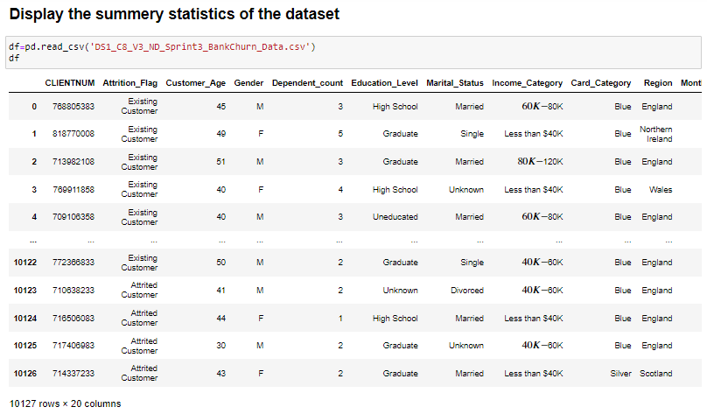
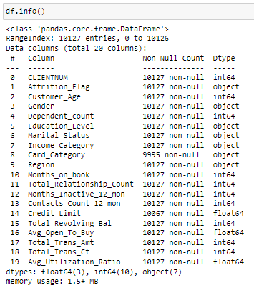
Summary statistics of Dataset
First we import the dataset into Python for pre-processing on it.
In this data we got a total of 10127 rows and 20 columns.
There are three data types present in the dataset.
Int64
Flot64
Object

Slide 6
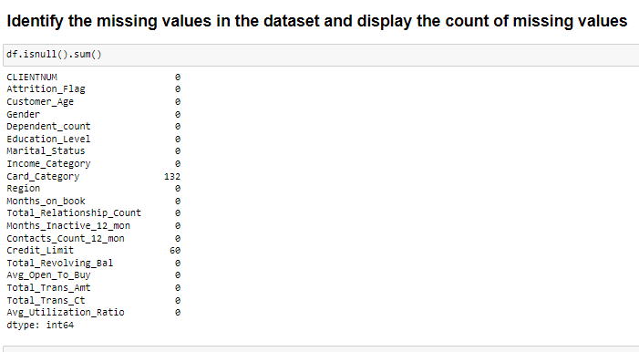
Identifying the missing values
After importing the data we are checking for null values present in the dataset.
We found that two columns have null values present in them.
The card category column has 132 null values
The credit limit column has 60 null values.
This null value affects the dt in further operations so, we need to process it.

Slide 7
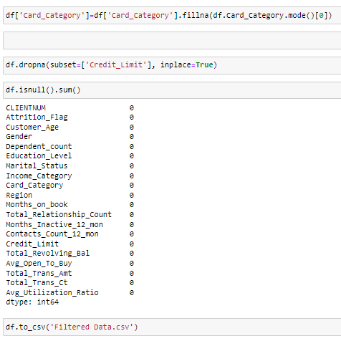
Perform Data imputation
For process on null values there are two methods.
Remove the null values
Replace it with the mode/mean value
In the first column of the card category, we are using the replacing method to replace the null values with the mode value.
For this method we use the ‘fillna’ command
In the second column of the card limit, we use the remove method to remove the null values from the Dataset.
For removing the rows we use the ‘drop’ command.
After the process we export the file into CSV format for Tableau

Slide 8

Tasks performed
Let’s Dive In

Slide 9
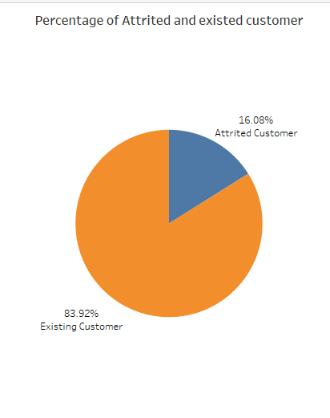
Task-1
In this task, we are showing the percentage of the Attrited and Existing Customers.
As per the output pie chart, the Attrited customer has only 16.08%.
The Existing customer has the highest number of counts around 83.92%.

Slide 10
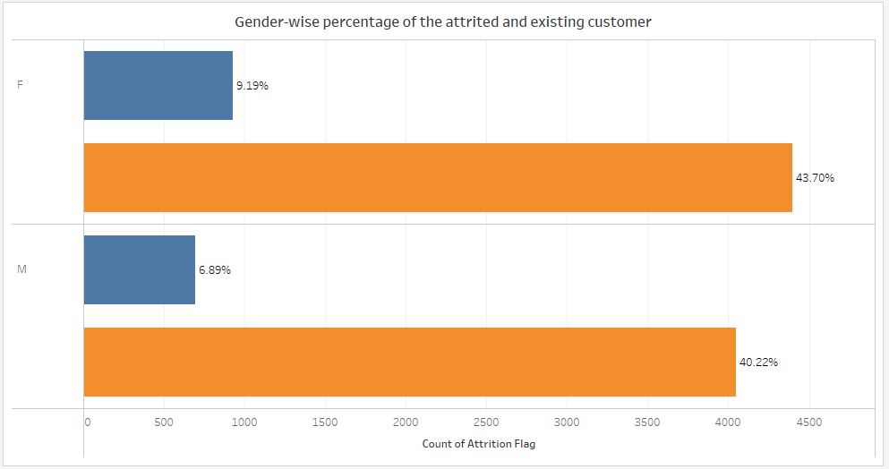
Task-2
In this task, we are showing the gender-wise percentage of the Attrited and Existing Customers.
As per the output chart, the Female customer has only 9.19% of Attrited customers and 43.70% of Existing customers.
The Male customer has 6.89% of Attrited customers and 40.22% has Existing customers.

Slide 11
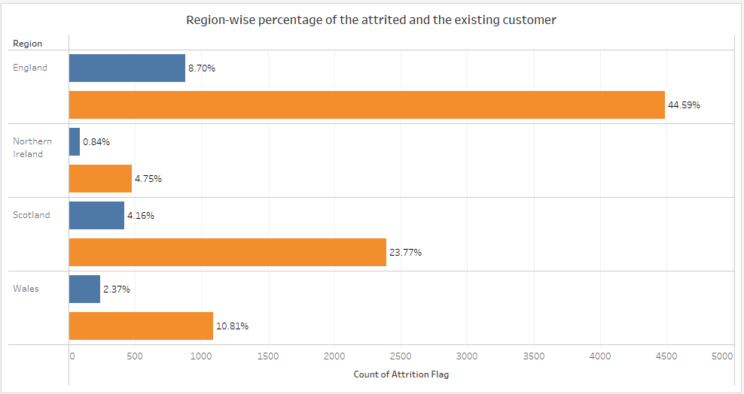
Task-3
In this task, we are showing the region-wise percentage of the Attrited and Existing Customers.
As per the output chart, England has the highest number of customers.
Around 8.70% are attrited and 44.59% are Existing customers.
Northern Ireland has a low amount of customers.
Around 0.84% are attrited and 4.75% are Existing customers.

Slide 12
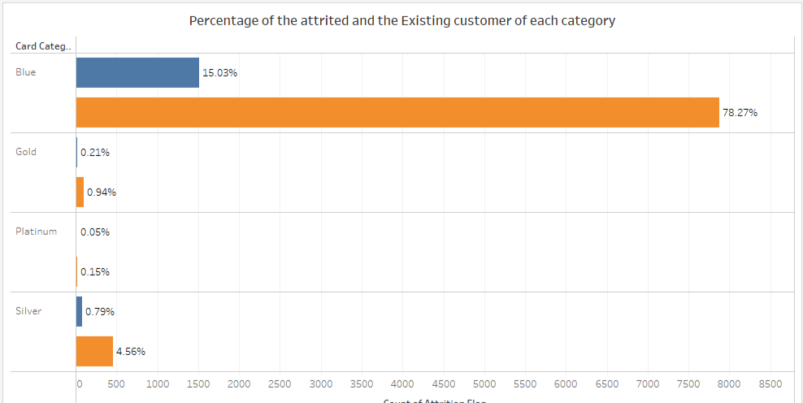
Task-4
In this task, we are showing the category-wise percentage of the Attrited and Existing Customers.
As per the output chart, the Blue Category has the highest number of customers.
Around 16.03% are attrited and 78.27% are Existing customers.
The Platinum category has a low amount of customers.
Around 0.22% are attrited and 0.94% are Existing customers.

Slide 13
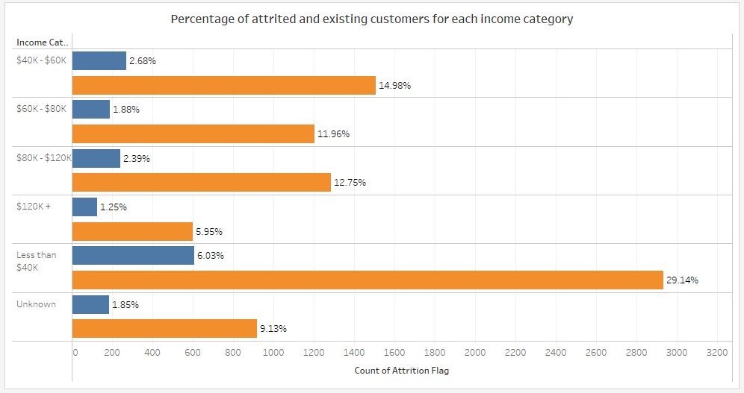
Task-5
In this task, we are showing the income category-wise percentage of the Attrited and Existing Customers.
As per the output chart, the less than 40k Category has the highest number of customers.
Around 6.03% are attrited and 29.14% are Existing customers.
The Unknown category has a low amount of customers.
Around 1.86% are attrited and 9.13% are Existing customers.

Slide 14
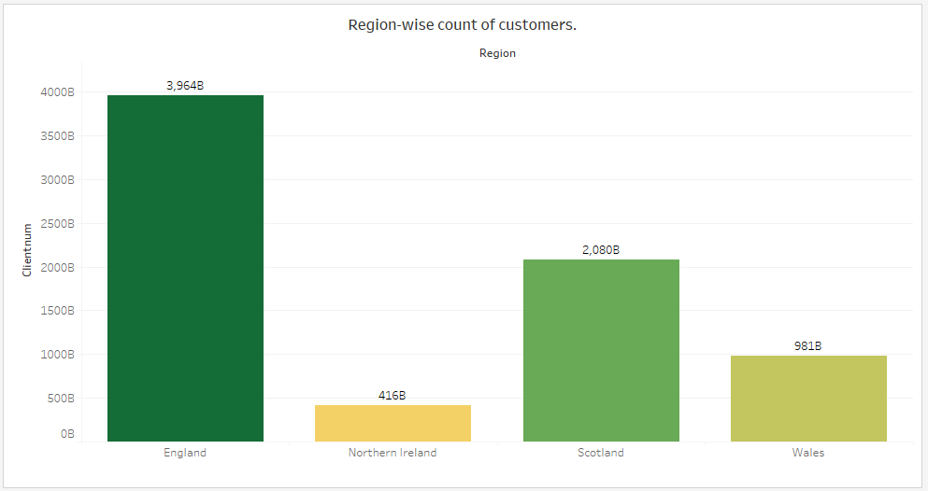
Task-6
In this task, we are showing the region-wise count of Customers.
As per the output chart, England has the highest number of customers.
Around 3964 Billion customers are present in England.
The Northern Ireland has a low amount of customers.
Around 416 Billion customers are present in Northern Ireland.

Slide 15
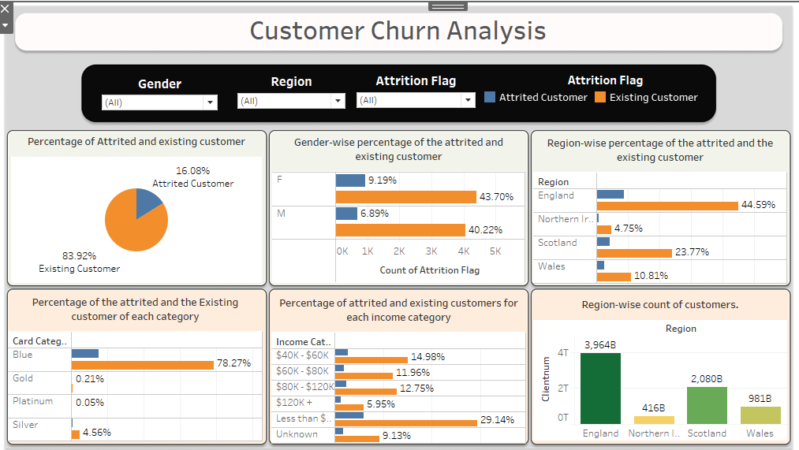
Dashboard

Slide 16
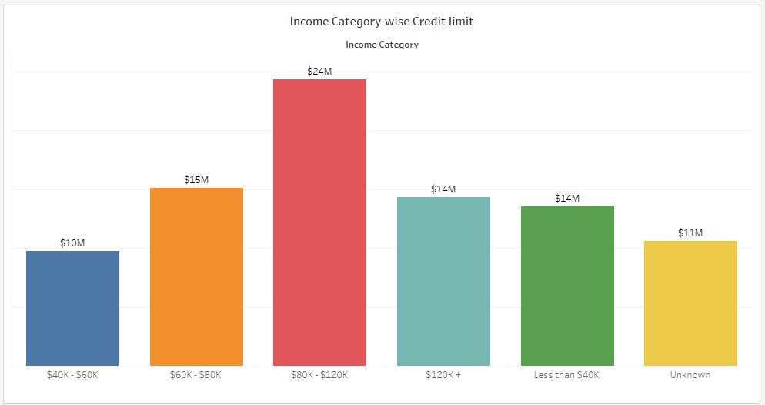
Task-7
In this task, we are showing the Income Category-wise credit limit.
As per the output chart, $80k-$20k has the highest number of credits allowed.
Around $24 Million credits are allowed.
The $40k-$60k has a low amount of credit allowed.
Around $10 Million credit allowed.

Slide 17
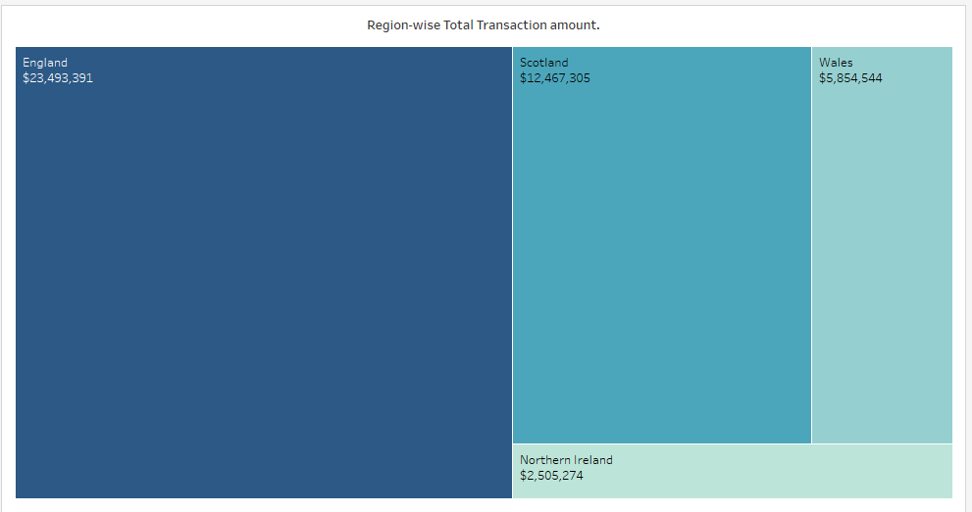
Task-8
In this task, we are showing the Region-wise transaction amount.
As per the output tree chart, England has the highest number of Transactions amount.
Around $23 Million Transaction amount.
Northern Ireland has a low amount of Transaction amount.
Around $2 Million credit allowed.

Slide 18
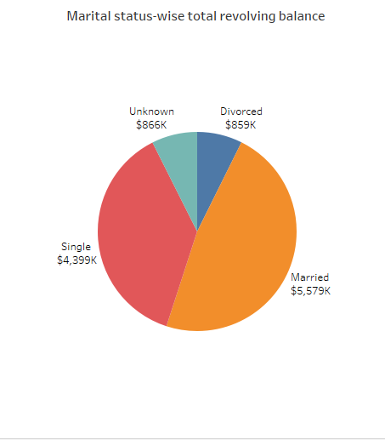
Task-9
In this task, we are showing the Marital Status-wise revolving balance.
As per the output Pie chart, Married Customer has the highest number of Revolving Balance.
Around $5,579 Thousand Revolving Balance amount.
Divorced has a low amount of Revolving Balance amount.
Around $859 Thousand Revolving Balance.

Slide 19
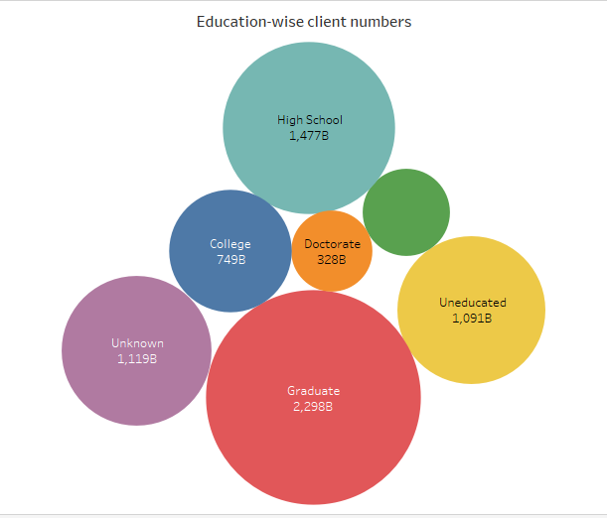
Task-10
In this task, we are showing the Education-wise Client number.
As per the output Bubble chart, Graduate has the highest number of Customers.
Around 2,298 Billion Customers.
Doctorate has a low amount of customers.
Around 328 Billion customers.

Slide 20
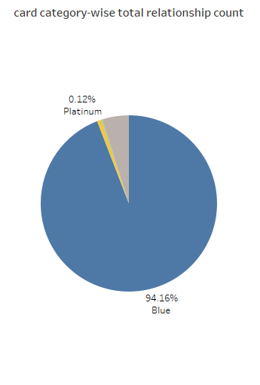
Task-11
In this task, we are showing the Card Category-wise Total Relationship Count.
As per the output Pie chart, the blue category has the highest number of Customers.
Around 94.6% Customers.
Platinum has a low amount of customers.
Around 0.12% customers.

Slide 21
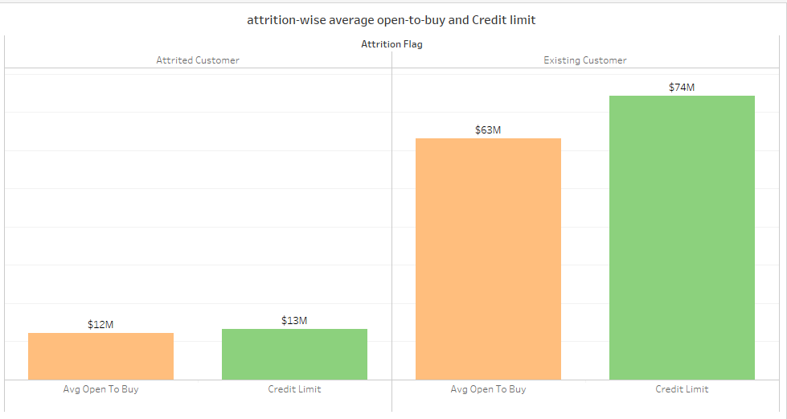
Task-12
In this task, we are showing the Attrition-wise Open-to-buy and Credit limit.
As per the output Bar chart, the Existing Customer has the highest number of Credit limits.
Around $74 Million Credit limits and $63 Million Open-to-buy.
Attrited Customer has low Credit limits.
Around 13 Million Credit limits and 12 Million Open-to-buy.

Slide 22
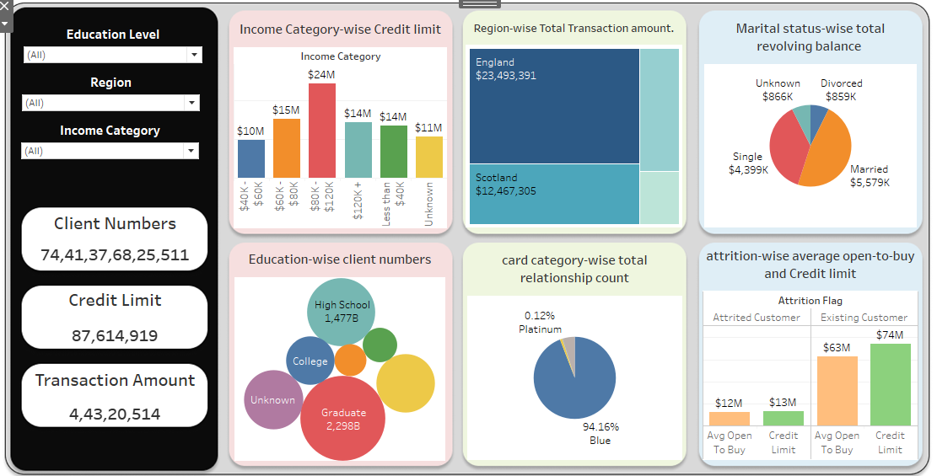
Dashboard

Slide 23

Conclusion
In the data, the number of existing customers is greater than Attrited customers.
The England Region is the great hub of the customers.
Most of the customers are Graduates.
The income of the customers is less than $40k.

Slide 24

THANK YOU
SANKET BHOSALE

